Slide 1
Integrative Plasmid Vectors for Zinc-Inducible Gene Expression in Cyanobacteria
Keith Herbert

Slide 2
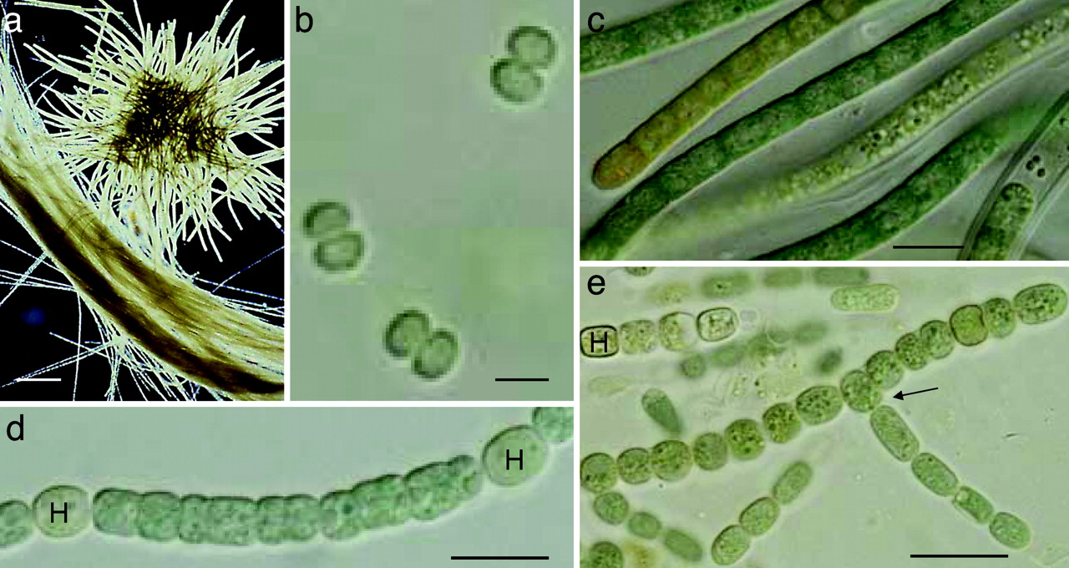
The Problem
Cox PA, Banack SA, Murch SJ, et al. Diverse taxa of cyanobacteria produce beta-N-methylamino-L-alanine, a neurotoxic amino acid. Proc Natl Acad Sci USA. 2005;102(14):5074-8.
Notes:
Cyanobacteria are awesome. Synthetic biology. Much interest for biofuels, special compounds, basic research into photosynthetic organisms.

Slide 3
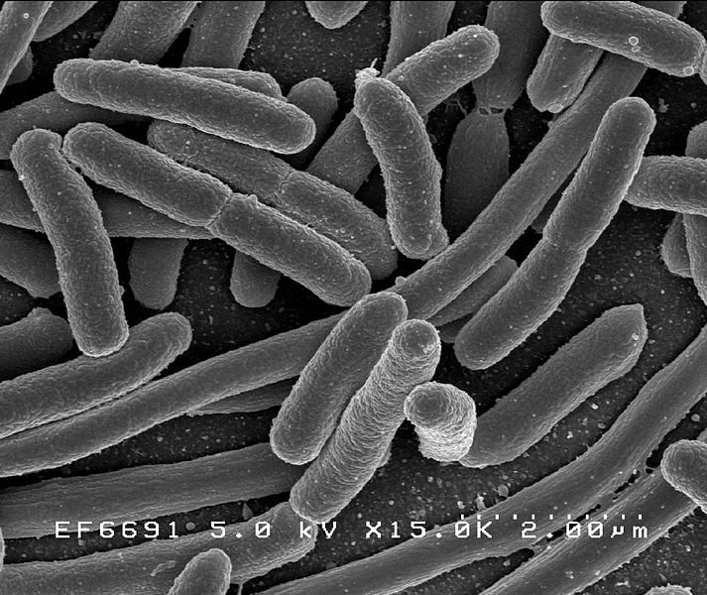
The Problem
Rocky Mountain Laboratories, NIAID, NIH
Notes:
We know much more about Ecoli than cyanobacteria. Workhorse model organism. Synthetic biology techniques pioneered with Ecoli.

Slide 4
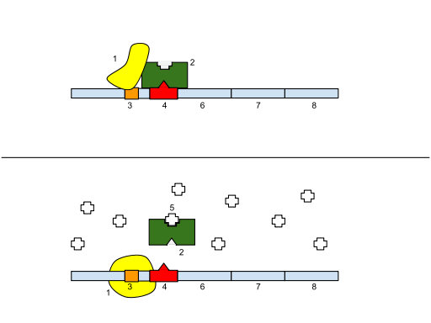
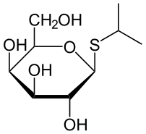
The Problem
IPTG
Lac Operon
http://en.wikipedia.org/wiki/File:IPTG2.svg
http://en.wikipedia.org/wiki/File:Lac_Operon.svg
Notes:
For example, Lac operon. Repressor responds to lactose (or substitute IPTG), releases from DNA to allow transcription.

Slide 5
The Problem
“Leaky” gene expression
Oliver JW, Machado IM, Yoneda H, Atsumi S. Cyanobacterial conversion of carbon dioxide to 2,3-butanediol. Proc Natl Acad Sci USA. 2013;110(4):1249-54.
Notes:
Expression of 2,3BD constant, despite changes in IPTG

Slide 6
The Problem
“Leaky” gene expression
Near constant 2,3-Butanediol
3 magnitudes of IPTG
Oliver JW, Machado IM, Yoneda H, Atsumi S. Cyanobacterial conversion of carbon dioxide to 2,3-butanediol. Proc Natl Acad Sci USA. 2013;110(4):1249-54.
Notes:
Expression of 2,3BD constant, despite changes in IPTG. This is not good.

Slide 7
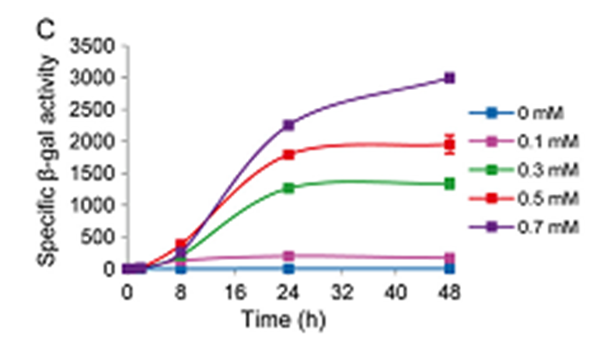
The Experiment
Promoter system to replace Lac operon
Metals ions instead of sugars
Gómez-santos N, Treuner-lange A, Moraleda-muñoz A, et al. Comprehensive set of integrative plasmid vectors for copper-inducible gene expression in Myxococcus xanthus. Appl Environ Microbiol. 2012;78(8):2515-21.

Slide 8
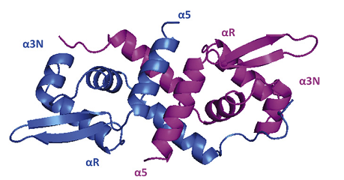
The Experiment
SmtB / ArsR Protein Family
Native to cyanobacteria
Repressors
Release on binding to metal ions. Transcription begins.
L. Botello-Morte et al., “Functional Genomics of Metalloregulators in Cyanobacteria”, Advances in Botanical Research, 65 (2013): 107-56

Slide 9
The Experiment
Cook WJ, Kar SR, Taylor KB, Hall LM. Crystal structure of the cyanobacterial metallothionein repressor SmtB: a model for metalloregulatory proteins. J Mol Biol. 1998;275(2):337-46.

Slide 10
The Experiment
RNA POLYMERASE
Cook WJ, Kar SR, Taylor KB, Hall LM. Crystal structure of the cyanobacterial metallothionein repressor SmtB: a model for metalloregulatory proteins. J Mol Biol. 1998;275(2):337-46.

Slide 11
The Experiment
L. Botello-Morte et al., “Functional Genomics of Metalloregulators in Cyanobacteria”, Advances in Botanical Research, 65 (2013): 107-56
Notes:
Imperfect 12-2-12 inverted repeat

Slide 12
The Experiment
SmtB Promoter
EcoRI
BamHI
HindIII
SalI
gene(s) of interest

Slide 13
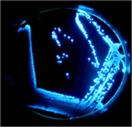
The Experiment
Bacterial luciferase (Lux) as reporter genes
Measure gene expression by light detected
http://en.wikipedia.org/wiki/File:Biolumplate.jpg

Slide 14
Follow Up
Submit plasmid to partsregistry.org as new BioBrick
Currently very few metal regulators
Enable new experiments with cyanobacteria

Slide 15
Follow Up
SmtB / ArsR protein family
Similar proteins differing by metal binding sites
Zn, Cu, Ag, Cd, Pb, Co, As, Sb
Fine tuned expression of multiple genes simultaneously by varying different metal concentrations

Slide 16
Questions?

Slide 17
Image References
Cox PA, Banack SA, Murch SJ, et al. Diverse taxa of cyanobacteria produce beta-N-methylamino-L-alanine, a neurotoxic amino acid. Proc Natl Acad Sci USA. 2005;102(14):5074-8.
Oliver JW, Machado IM, Yoneda H, Atsumi S. Cyanobacterial conversion of carbon dioxide to 2,3-butanediol. Proc Natl Acad Sci USA. 2013;110(4):1249-54.
Gómez-santos N, Treuner-lange A, Moraleda-muñoz A, et al. Comprehensive set of integrative plasmid vectors for copper-inducible gene expression in Myxococcus xanthus. Appl Environ Microbiol. 2012;78(8):2515-21.
Cook WJ, Kar SR, Taylor KB, Hall LM. Crystal structure of the cyanobacterial metallothionein repressor SmtB: a model for metalloregulatory proteins. J Mol Biol. 1998;275(2):337-46
L. Botello-Morte et al., “Functional Genomics of Metalloregulators in Cyanobacteria”, Advances in Botanical Research, 65 (2013): 107-56
Rocky Mountain Laboratories, NIAID, NIH
Wikimedia Commons:
en.wikipedia.org/wiki/File:IPTG2.svg
en.wikipedia.org/wiki/File:Lac_Operon.svg
en.wikipedia.org/wiki/File:Biolumplate.jpg

